Slide 1


K. RAMAKRISHNAN COLLEGE OF ENGINEERING
(AUTONOMOUS), SAMAYAPURAM - TRICHY
DEPARTMENT OF ARTIFICIAL INTELLIGENCE AND MACHINE LEARNING
AMC1361 – MOBILE APPLICATION DEVELOPMENT
PHARMA CARE
PRESENTED BY SUPERVISOR
NALINAA A C Mr.P.Nagaraj
PINGALA PRAGNA A Assistant Professor / AIML
SRI KARUNYA S S K
THULASI C

Slide 2

PRESENTATION OVERVIEW
Abstract
Project Introduction
Objective
Literature Survey
Research gap
Existing System and Proposed System
Tools & Technologies
Architecture Diagram
Modules Used
Output
Conclusion
Future Scope
References

Slide 3
ABSTRACT
PharmaCare is a mobile application designed to simplify medicine-related activities.
It provides a centralized platform for medicine discovery and healthcare management.
Users can handle prescriptions, purchases, reminders and pharmacy information.
Firebase provides backend support for authentication, data storage and notifications.
The application aims to make medicine management accessible, organized and convenient.

Slide 4
PROJECT INTRODUCTION
Users can browse medicines according to categories such as tablets, syrups and capsules.
Detailed information such as price, dosage and availability can be displayed.
Doctor prescriptions can be captured or selected from the device camera or gallery.
The application maintains important activities such as orders, reminders and medication history.
An administrator can control the application's medicine and customer-related operations.

Slide 5
OBJECTIVE
To develop a mobile-based platform for managing medicine-related requirements.
To provide a structured method for handling digital prescriptions.
To support cart-based medicine purchasing and order processing.
To assist users in maintaining their regular medication schedules.
To provide administrative facilities for managing the overall system.

Slide 6
LITERATURE SURVEY
Existing online pharmacy applications provide features for medicine search, product information and online ordering.
Medication reminder applications help users schedule medicines and receive timely notification alerts.
Digital prescription systems allow users to upload, store and manage prescriptions electronically.
Location-based healthcare applications help users identify nearby pharmacies and access navigation services.
Existing solutions mainly focus on individual healthcare functions, creating a need for an integrated medicine management application.

Slide 7
RESEARCH GAP
Medicine purchasing and medication scheduling are commonly handled through different solutions.
Prescription records may not be directly connected to the medicine purchasing process.
Pharmacy discovery and online medicine services can exist as separate functions.
Users may have to switch between different platforms to complete related activities.
PharmaCare addresses this gap through a single integrated mobile application.
.

Slide 8
EXISTING SYSTEM VS PROPOSED SYSTEM
Existing System | Proposed System
Medicine purchasing may require separate pharmacy services. | Provides a dedicated online medicine ordering interface.
Prescription handling can involve physical documents. | Supports digital prescription upload and storage.
Medication schedules may be maintained separately. | Provides an integrated medicine reminder facility.
Pharmacy information may require a separate location service. | Provides nearby pharmacy discovery within the application.
Different activities may require multiple platforms. | Combines major medicine-management activities in one application.
.

Slide 9
TOOLS & TECHNOLOGIES
Flutter – Used to design and develop the mobile application interface.
Dart – Programming language used for implementing application functionality.
Firebase Authentication – Used for user registration and login management.
Cloud Firestore & Firebase Storage – Used for structured data and prescription/file storage.
Android Studio – Development environment used to build, run and test the application.
.

Slide 10
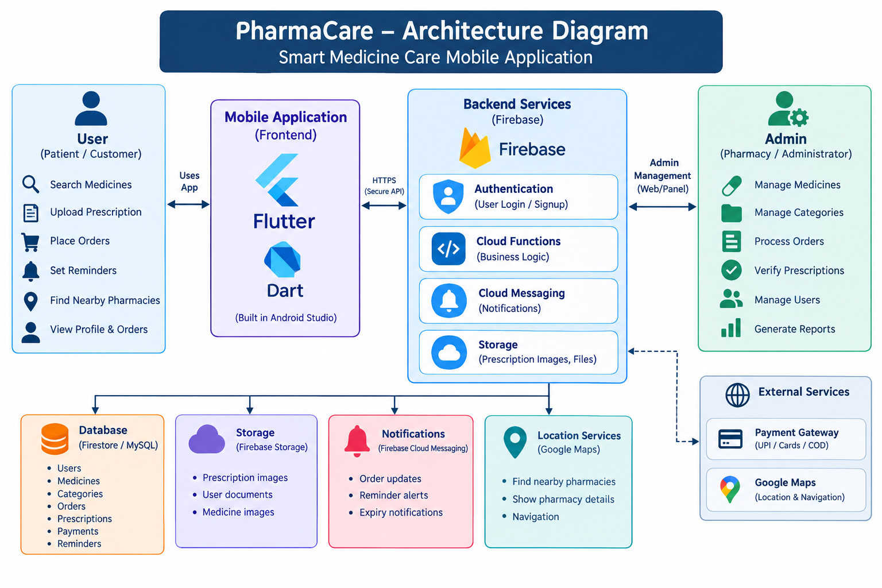
ARCHITECTURE DIAGRAM
.

Slide 11
MODULES USED
1.User Module
Provides user registration and login.
Allows users to create and maintain their personal profile.
Users can add and update their delivery address.
Personal information can be managed from the profile section.
Authentication helps provide controlled access to user accounts.

Slide 12
MODULES USED
2.Medicine Search Module
Users can search medicines using their medicine name.
Medicines can be organized into categories such as tablets, syrups and capsules.
Users can view medicine descriptions and details.
The application can display price and availability.
This module helps users quickly identify the medicine they requir

Slide 13
MODULES USED
3.Prescription Upload Module
Users can upload a doctor's prescription through the camera or gallery.
The prescription is stored digitally in the application.
Uploaded prescriptions can be sent for pharmacist verification.
Prescription records can be associated with the user's account.
Secure storage helps protect uploaded prescription information.

Slide 14
MODULES USED
4.Medicine Order Module
Users can select medicines and add them to the shopping cart.
The cart displays the medicines selected for purchase.
Users can confirm their delivery details before ordering.
The system can support payment methods such as UPI, cards and Cash on Delivery.
Users can view the status and history of their orders.

Slide 15
MODULES USED
5.Medicine Reminder Module
Users can create reminders for their daily medicines.
Reminder schedules can include medicine name and timing.
The application sends notification alerts at scheduled times.
Users can record whether a medicine dose was taken or missed.
Medication history can help users monitor their regular medicine schedule.

Slide 16
MODULES USED
6.Nearby pharmacy module
Uses location services to identify pharmacies near the user.
Displays available pharmacy information.
Users can view pharmacy name and contact details.
Location information can be displayed using maps.
Navigation support can help users reach the selected pharmacy.

Slide 17
MODULES USED
7.Admin Module
Admin can add, update and delete medicines.
Admin can create and manage medicine categories.
Admin can monitor and process customer orders.
Admin can review and verify uploaded prescriptions.
Admin can manage users and generate system reports and analytics.

Slide 18
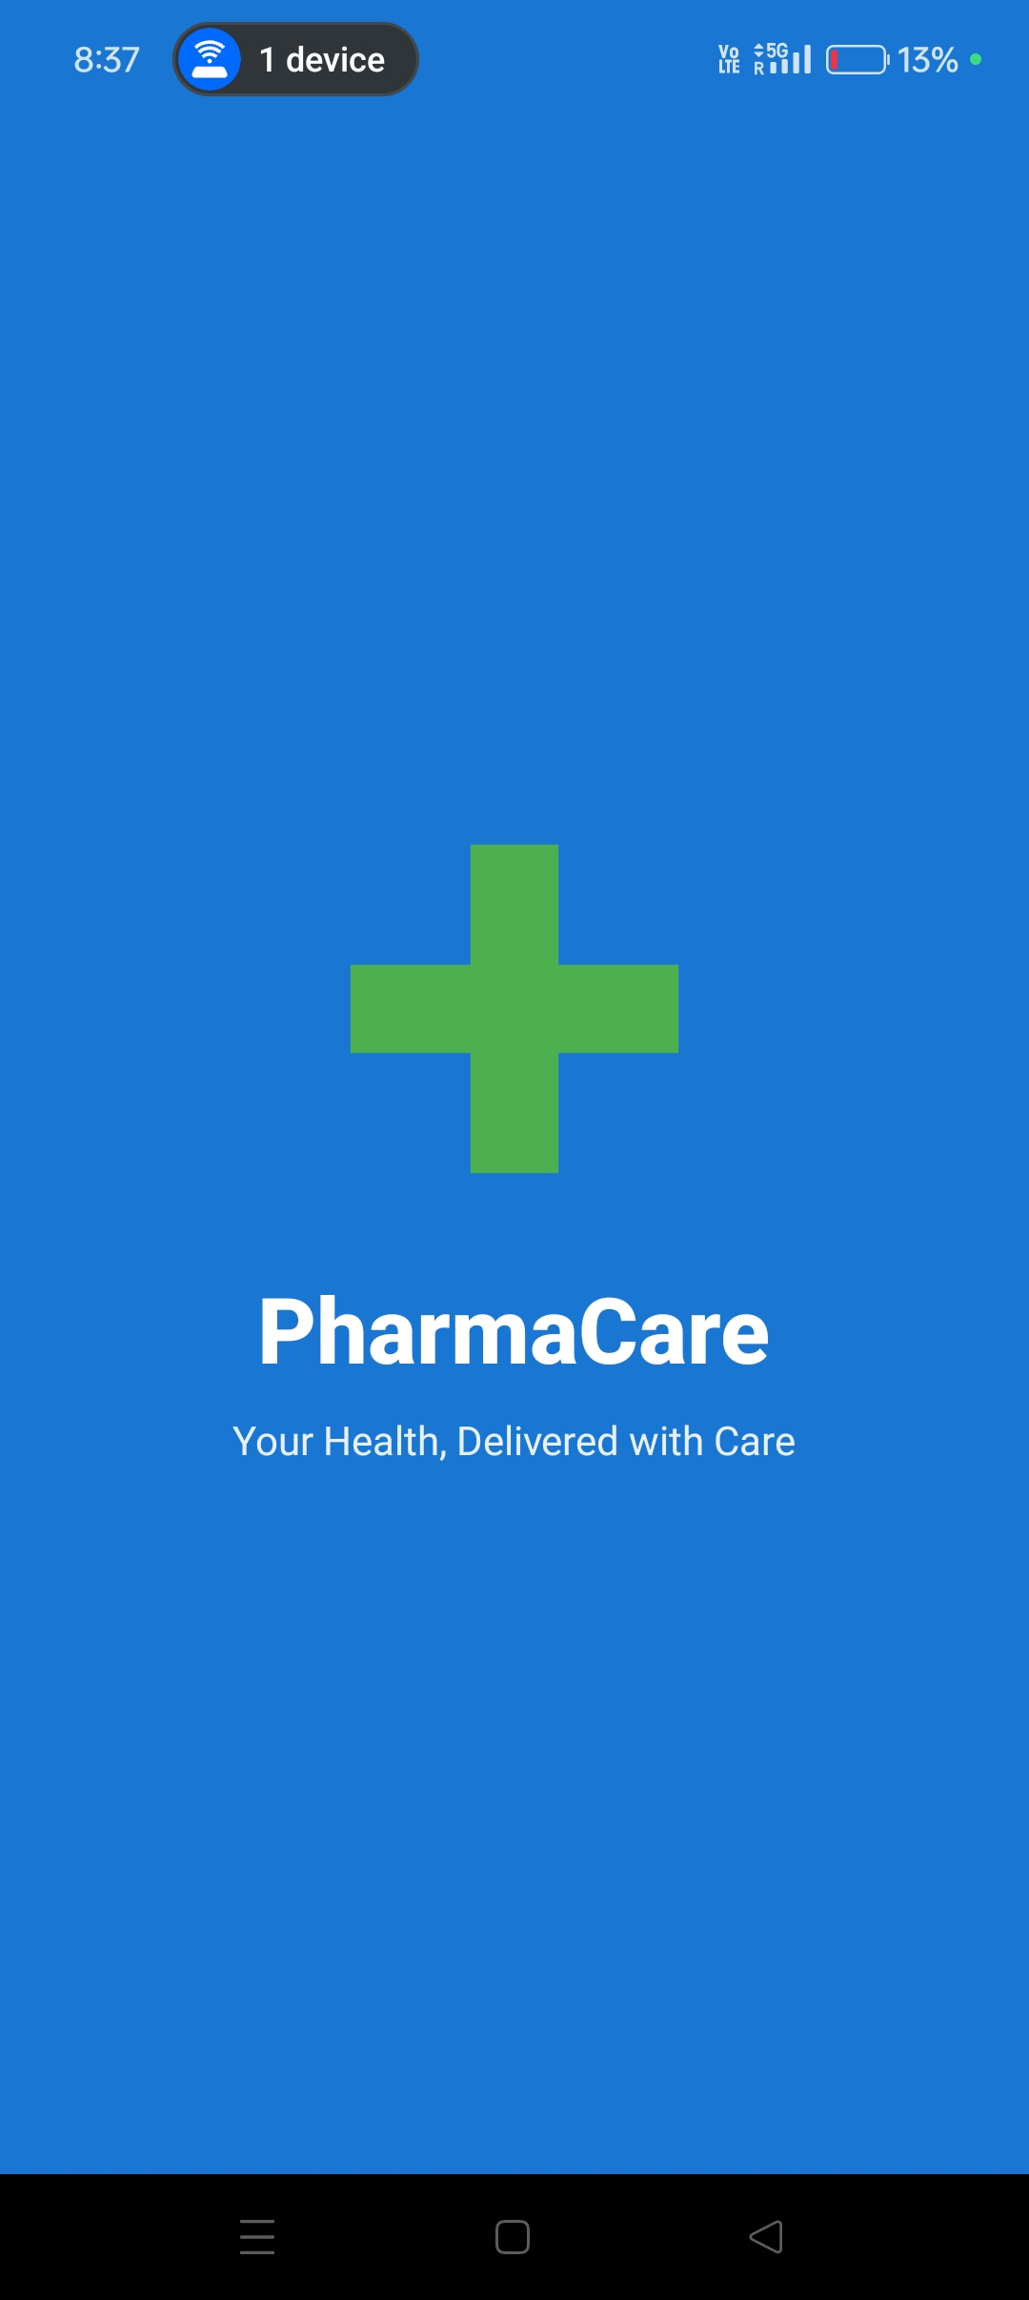
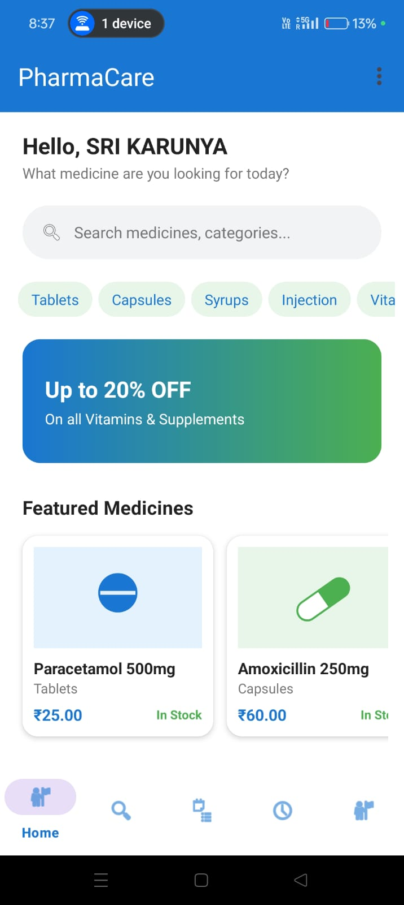
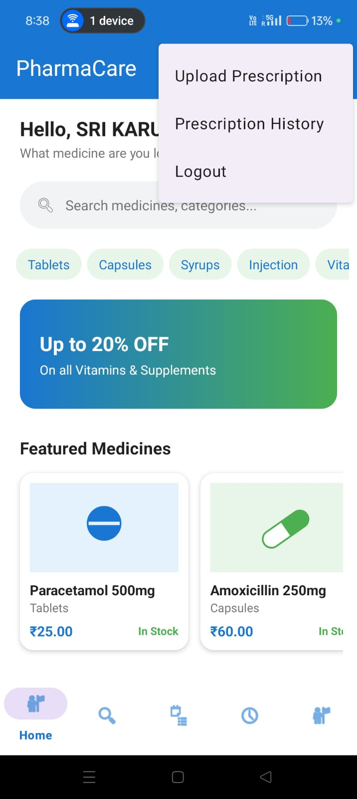
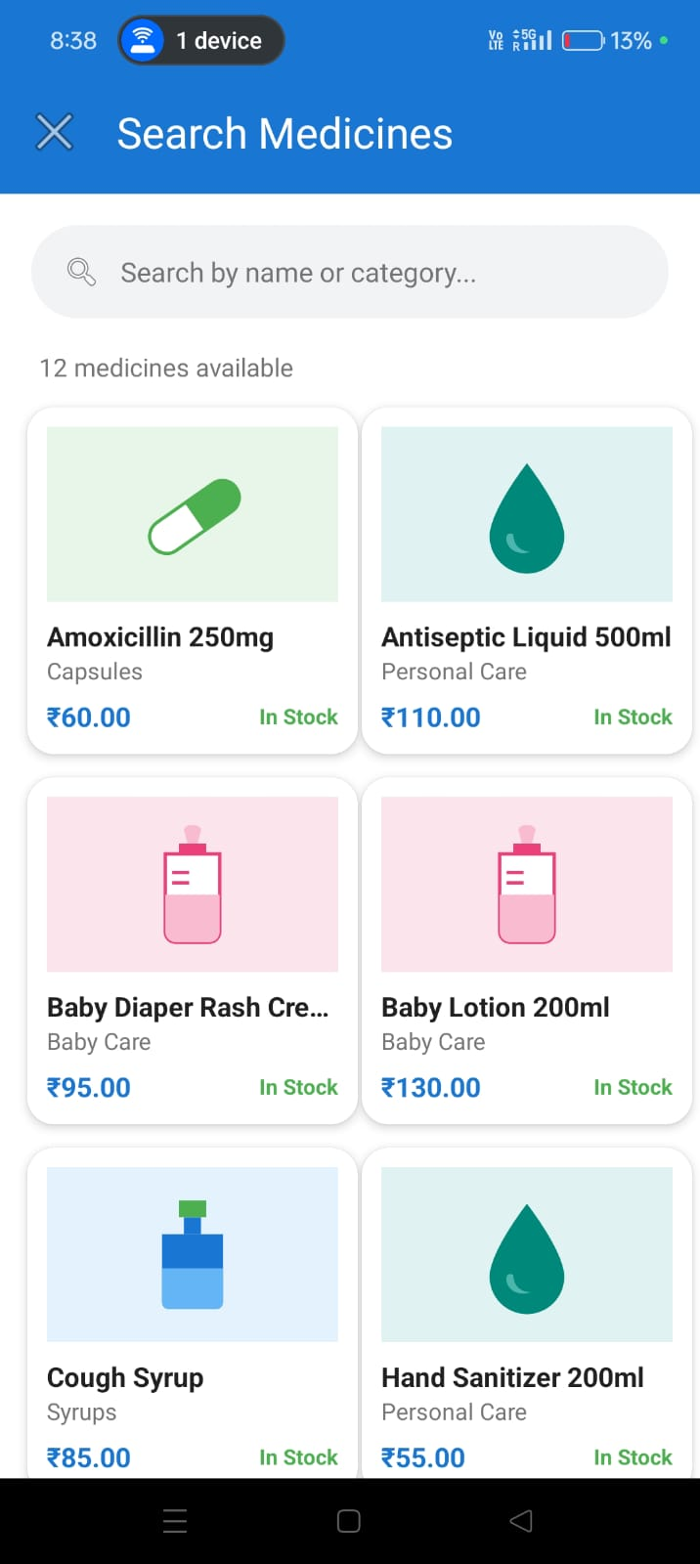
OUTPUT SCREENSHOTS

Slide 19
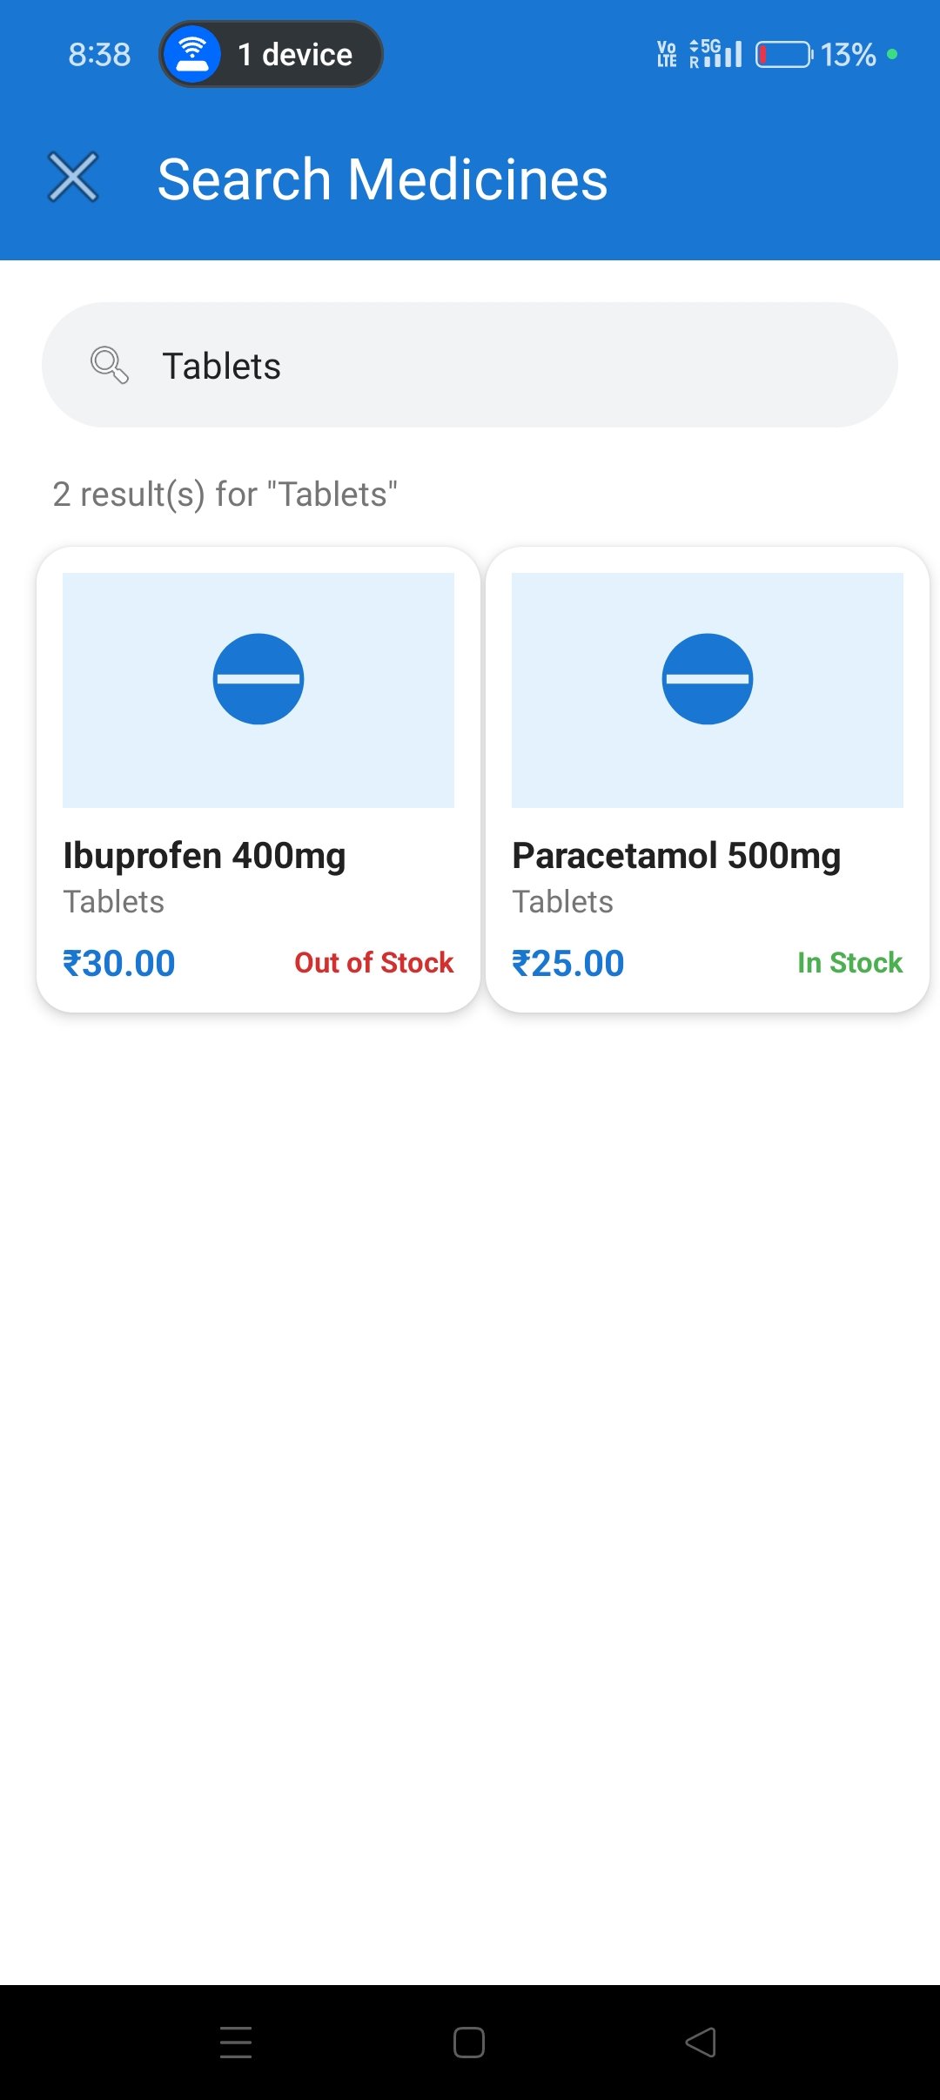

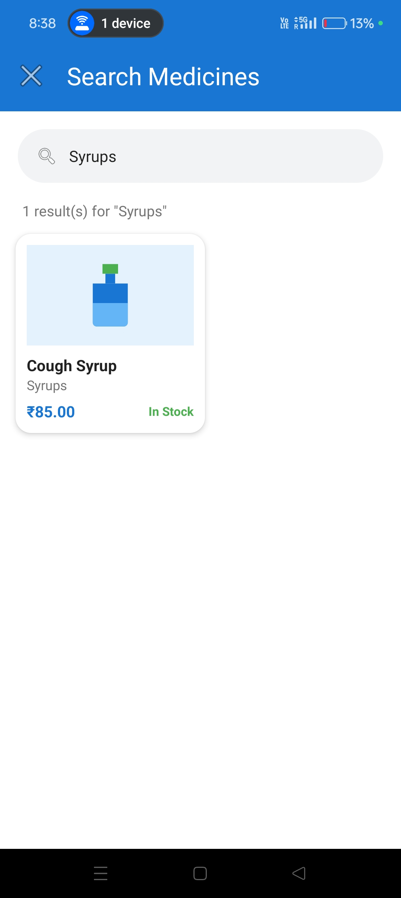
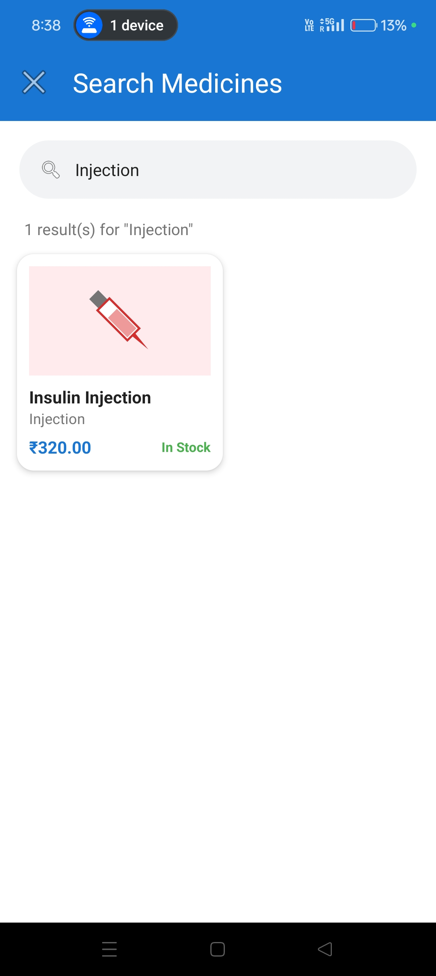
OUTPUT SCREENSHOTS

Slide 20
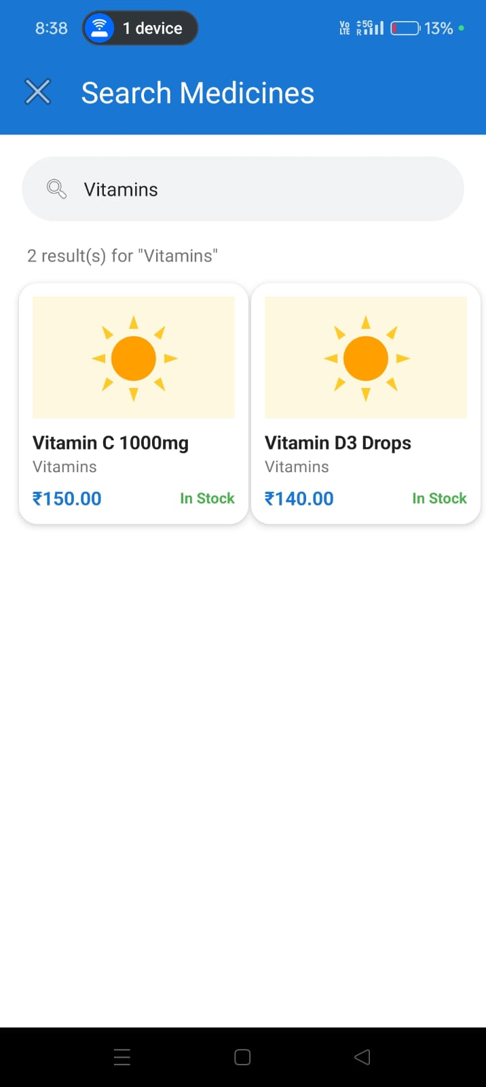
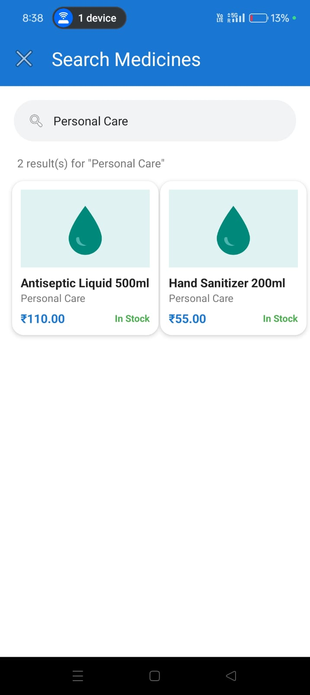
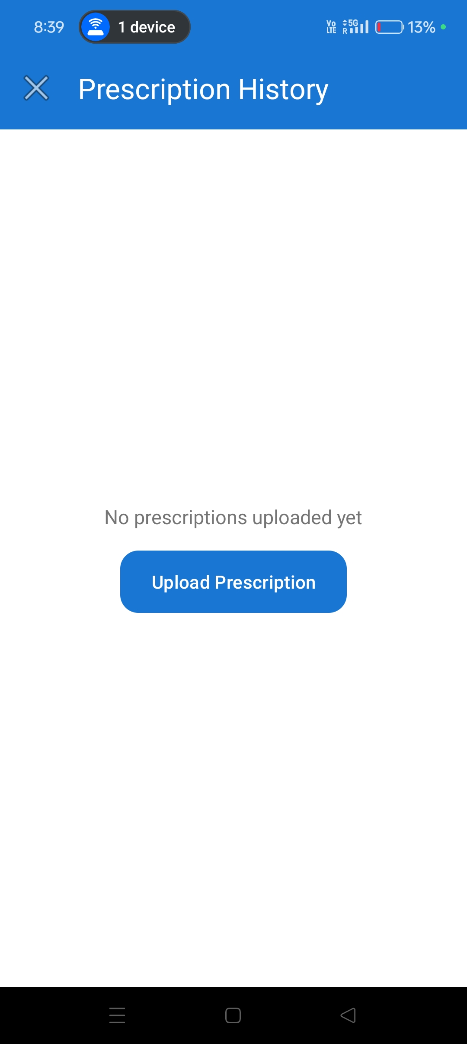
OUTPUT SCREENSHOTS

Slide 21
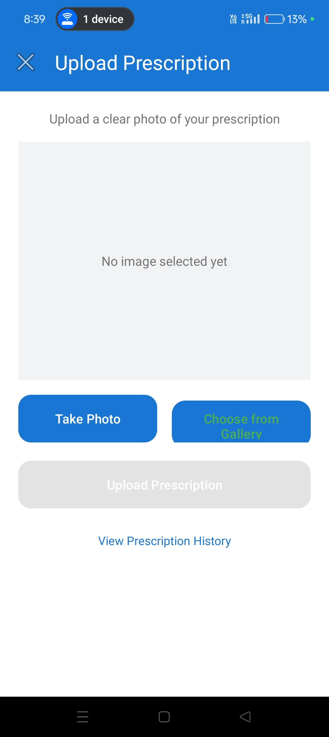
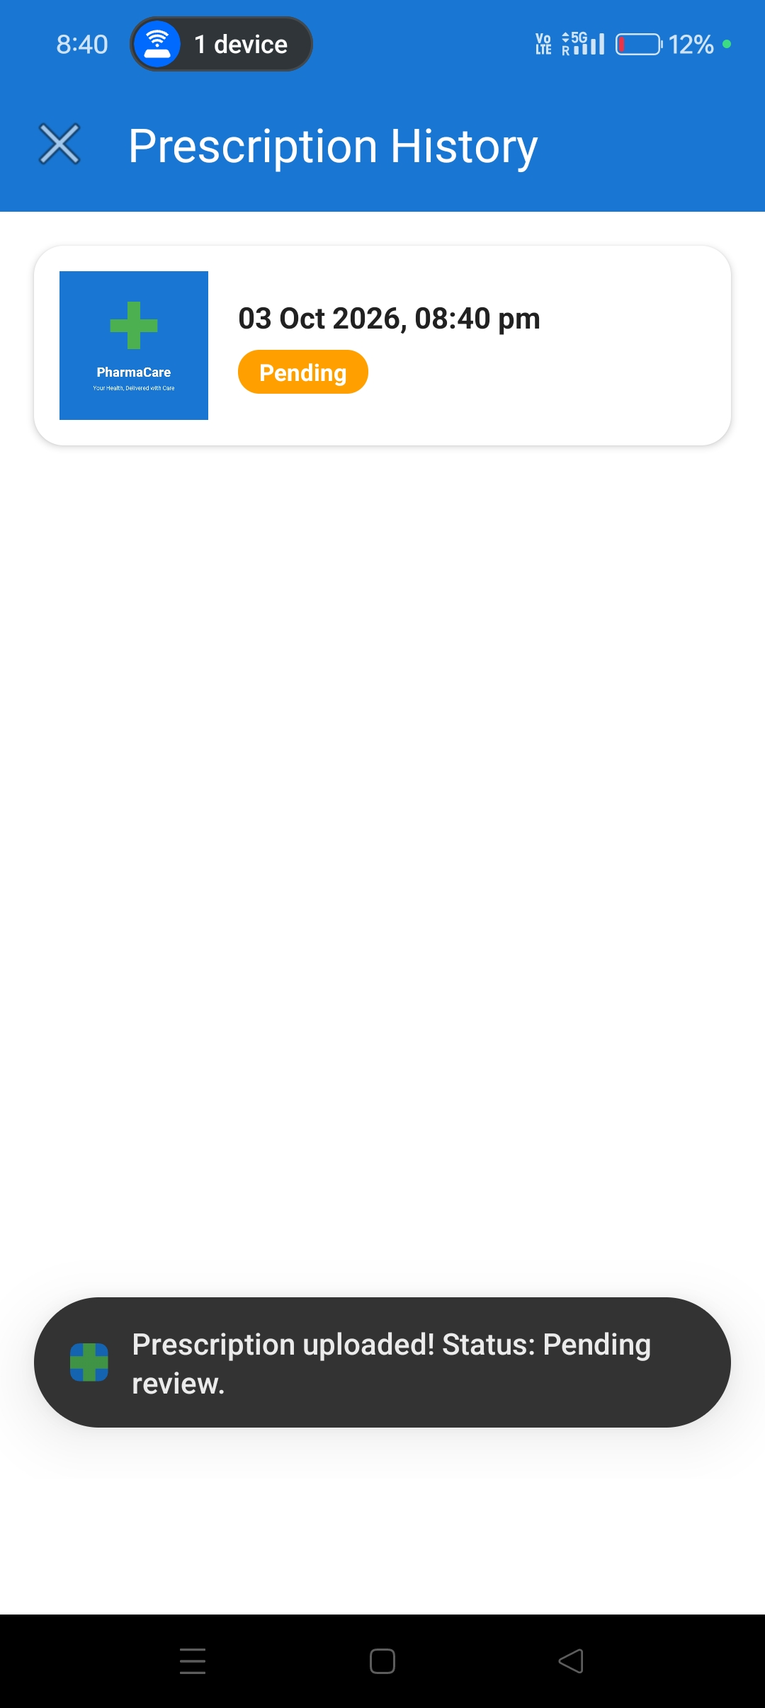
OUTPUT SCREENSHOTS

Slide 22
CONCLUSION
PharmaCare provides a centralized mobile solution for medicine-related activities.
The application connects medicine browsing, prescription handling and purchasing.
Reminder functionality supports users in maintaining scheduled medication activities.
Firebase provides the required infrastructure for authentication and application data.
The modular design allows PharmaCare to be extended with additional healthcare features.

Slide 23
FUTURE SCOPE
AI Chatbot can provide basic assistance for medicine-related queries.
Expiry Alerts can notify users before stored medicines reach their expiry date.
QR Verification can provide an additional method for checking medicine information.
Tamil and English support with voice search can improve accessibility.
Doctor consultation and emergency ordering can extend the application's healthcare services.

Slide 24
REFERENCES
Flutter Documentation – Framework and mobile application development.
Dart Documentation – Programming language reference.
Firebase Documentation – Authentication, Firestore and Storage.
Android Developers Documentation – Android Studio and application development.
Google Maps Platform Documentation – Location and navigation services.

Slide 25


